Slide 1
Bank Marketing Dataset

Slide 2
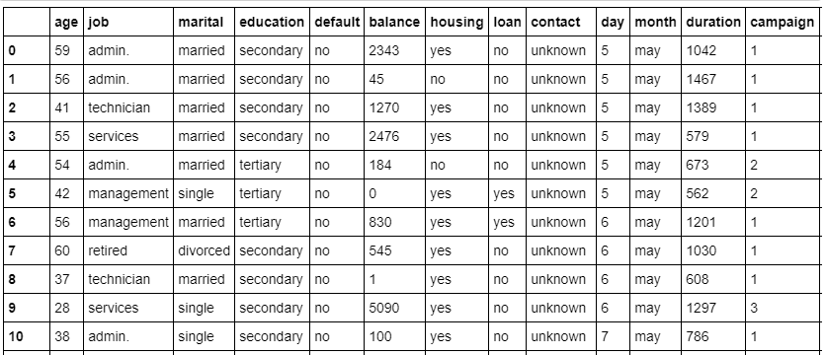
Data Analysis
Target: classification goal is to predict if the client will subscribe a term deposit

Slide 3
Feature Description
1 - age: (numeric) 2 - job: type of job (categorical: 'admin.','blue-collar','entrepreneur','housemaid','management','retired','self-employed','services','student','technician','unemployed','unknown') 3 - marital: marital status (categorical: 'divorced','married','single','unknown'; note: 'divorced' means divorced or widowed) 4 - education: (categorical: primary, secondary, tertiary and unknown) 5 - default: has credit in default? (categorical: 'no','yes','unknown') 6 - housing: has housing loan? (categorical: 'no','yes','unknown') 7 - loan: has personal loan? (categorical: 'no','yes','unknown') 8 - balance: Balance of the individual.

Slide 4
8 - contact: contact communication type (categorical: 'cellular','telephone') 9 - month: last contact month of year (categorical: 'jan', 'feb', 'mar', ..., 'nov', 'dec') 10 - day: last contact day of the week (categorical: 'mon','tue','wed','thu','fri') 11 - duration: last contact duration, in seconds (numeric). Important note: this attribute highly affects the output target (e.g., if duration=0 then y='no'). Yet, the duration is not known before a call is performed. Also, after the end of the call y is obviously known. Thus, this input should only be included for benchmark purposes and should be discarded if the intention is to have a realistic predictive model.

Slide 5
12 - campaign: number of contacts performed during this campaign and for this client (numeric, includes last contact) 13 - pdays: number of days that passed by after the client was last contacted from a previous campaign (numeric; 999 means client was not previously contacted) 14 - previous: number of contacts performed before this campaign and for this client (numeric) 15 - poutcome: outcome of the previous marketing campaign (categorical: 'failure','nonexistent','success')
Output variable (desired target): 21 - y - has the client subscribed a term deposit? (binary: 'yes','no')

Slide 6
Features Selected
Target variable: Deposit
Predict Variable: marital, duration, pdays, loan, education

Slide 7
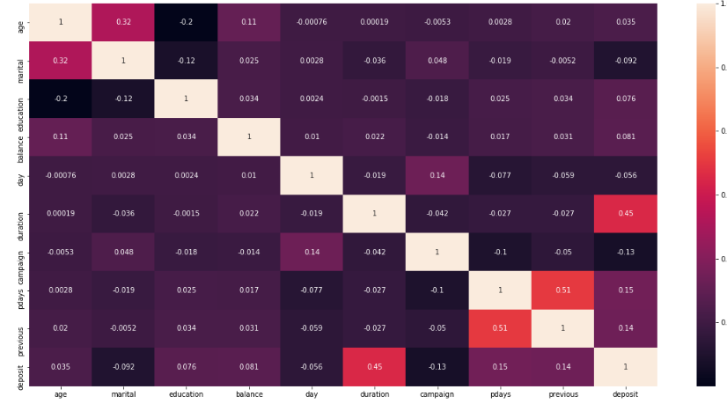
Visualization

Slide 8

Confusion Matrix

Slide 9
Accuracy Metrics
Accuracy: 0.74
Precision: 0.75
Recall: 0.65
Sepicificity: 0.82
F1 Score: 0.7

Slide 10
Thank You

